Slide 1
Share process of building front-end development environment

Slide 2
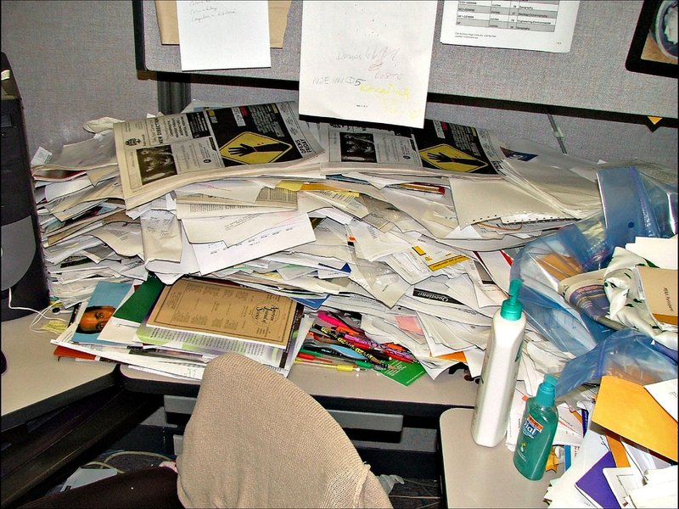
Javascript, html, css, image, etc.
How can handle that?

Slide 3
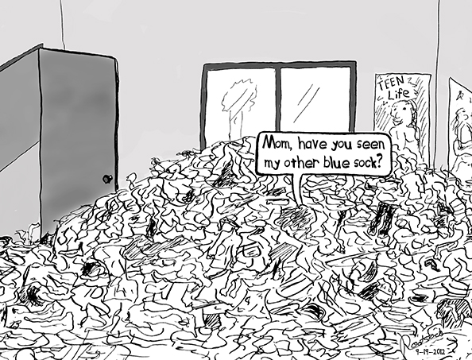
Using too much third-party
How can another dev get all of these?
Third-party version?

Slide 4
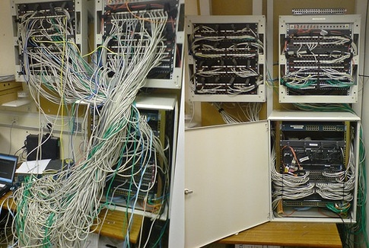
Want reorder structure folder of project?
This component is awesome but wrong place.

Slide 5

Version?
How the client can reach latest version?

Slide 6

Unit test
Other change my code but … another dev is crying

Slide 7
E2E
Test again and (again)x888888
old screen or diving in new features

Slide 8
Thank you!!!

